Slide 1
Funding and Finance
= Fun??
Elspeth Broady
London Rd (Brighton) Station Partnership
lrsp@hotmail.co.uk
Notes:
Funding and finance is often the bit that worries us most

Slide 2
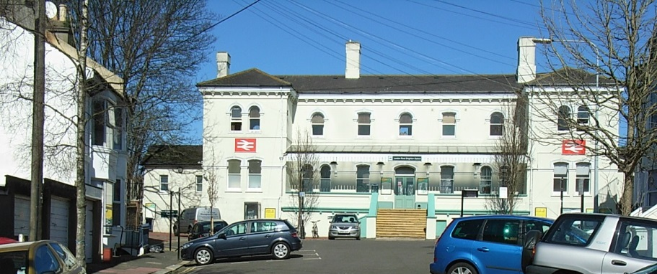
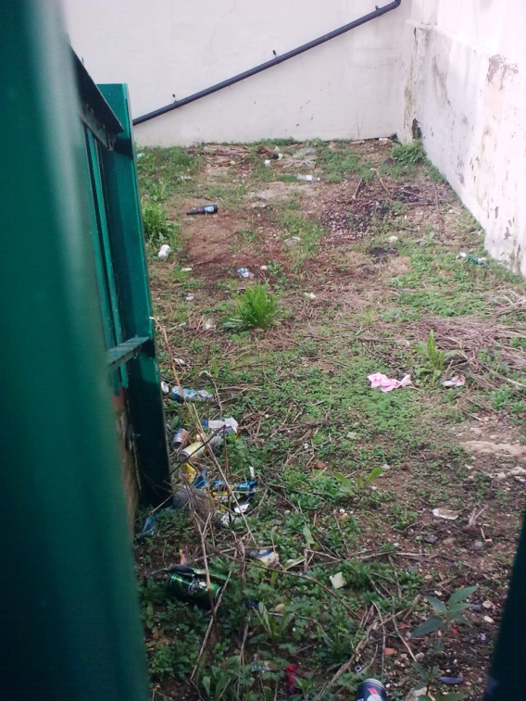
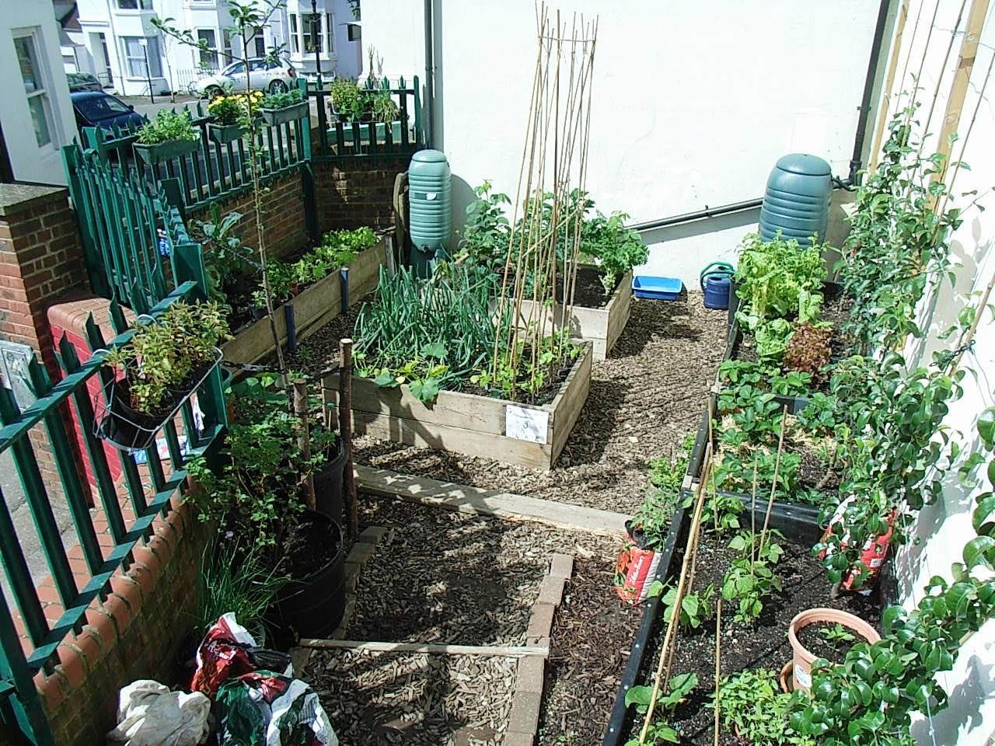
CASE STUDY 1 – Getting started

Slide 3
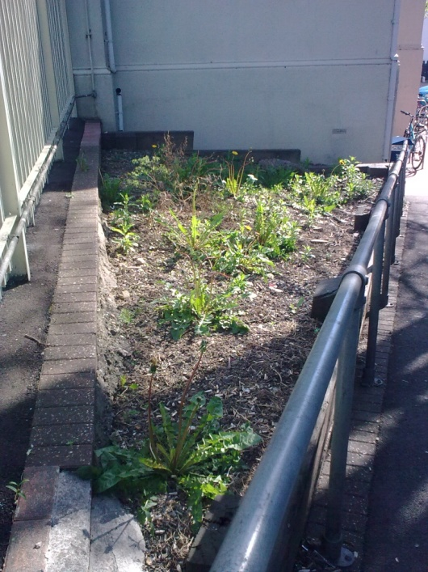
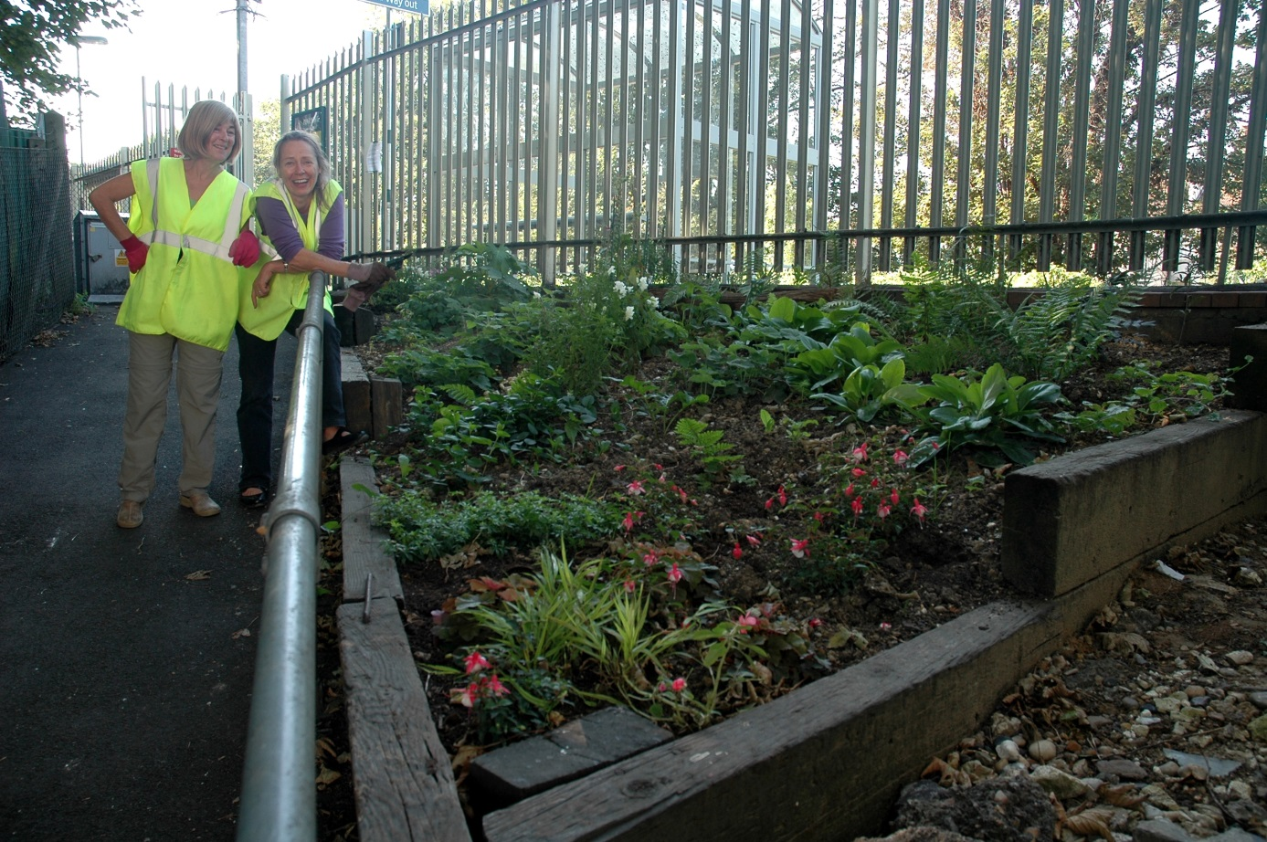

Slide 4
Soil
Water butts
Chipped bark
Pots
Plants
Advice
Neighbours, Veolia, stables
Southern Rail/Southern Water
Southern Rail
Neighbours and us
Neighbours and us
Harvest, BHFP
And then … an unsollicited donation of £100 from a local business!

Slide 5
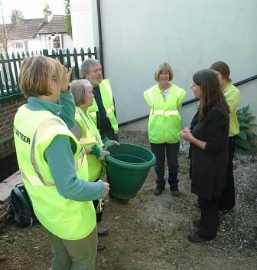
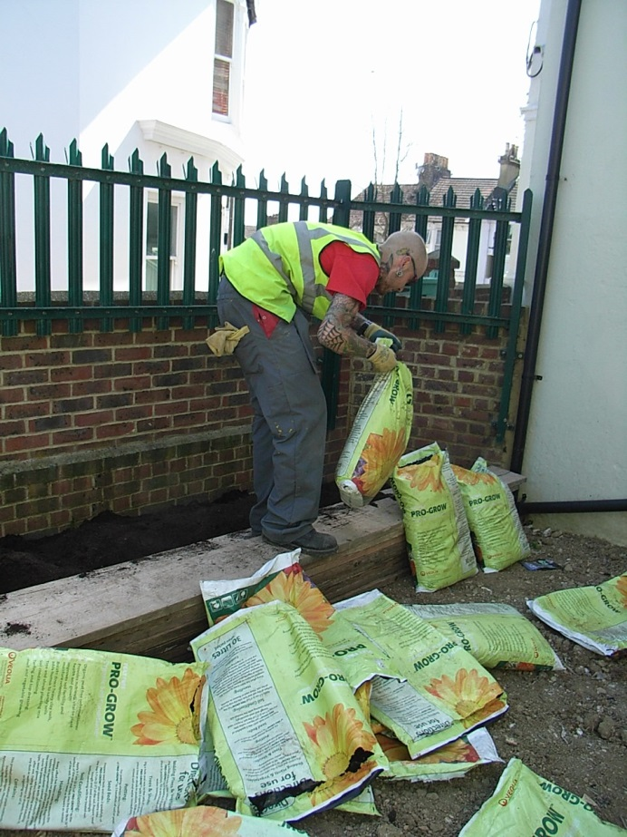
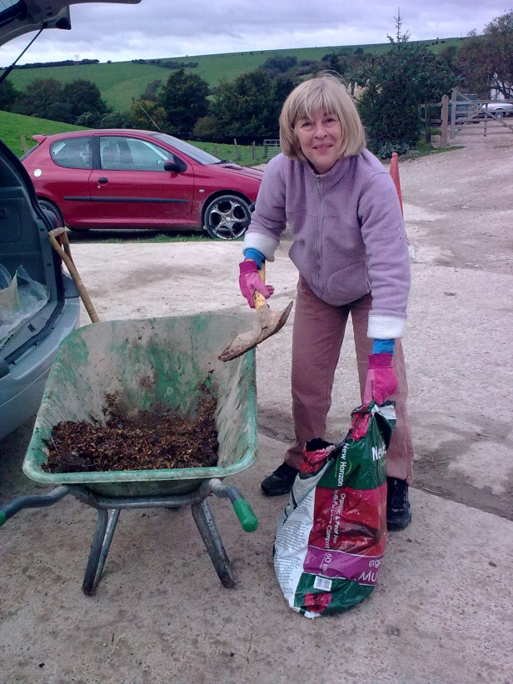
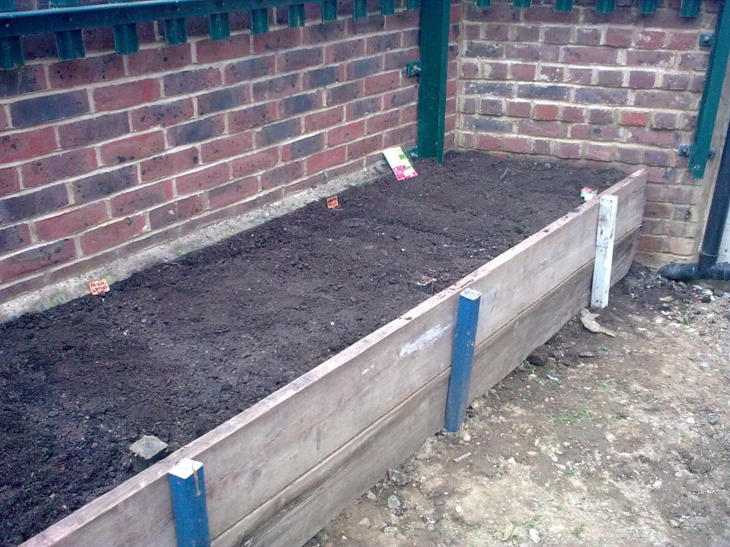
Beg, borrow and …
build relationships

Slide 6
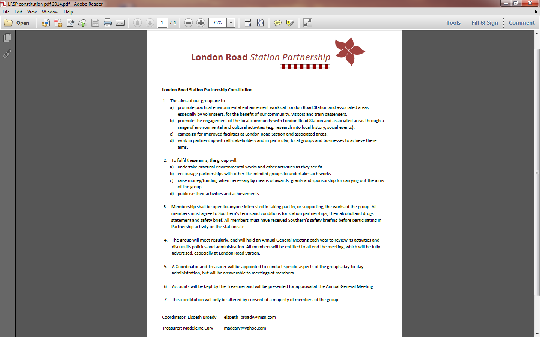
A bank account and a constitution

Slide 7
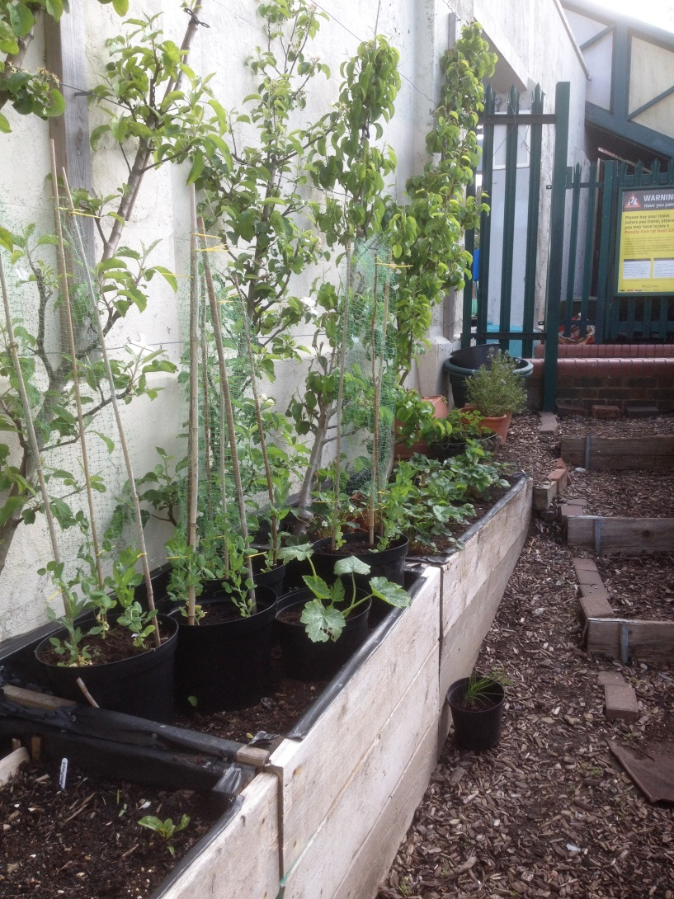
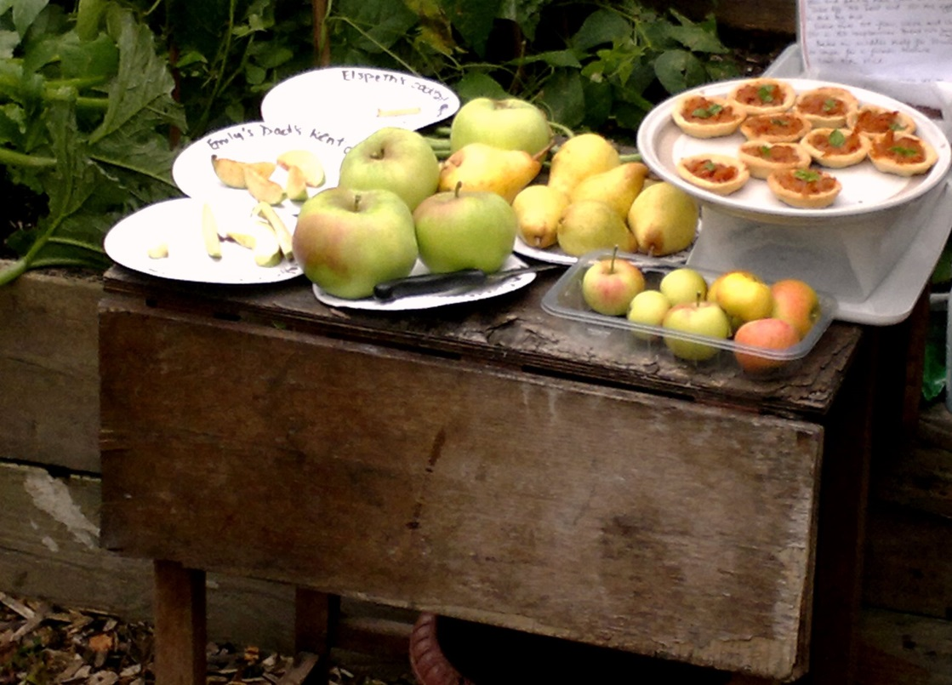
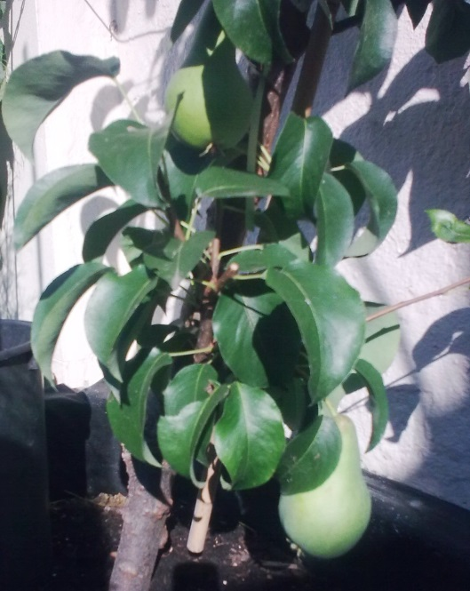
CASE STUDY 2 – The mini-orchard

Slide 8
“You can have: 7 fruit trees, expert help planting them, an free apple-based community lunch at the planting event for all attendees, 2 free places on a day training course on fruit trees, 4 free follow-up training sessions on pruning …”
“… but you need to pay £200, then you need to build 4 raised beds, fill them with soil, paint a wall, erect battens and training wires and publicise the event … and you’ve got no more than 3 weeks to do it!”

Slide 9
£200 for trees etc
scaffolding planks
soil
battens and wires
publicity
grant from BHFP?
local scaffolders
Country Style, BPT
£100 sponsorship from local pubs
donations from attendees?
self-funding?

Slide 10
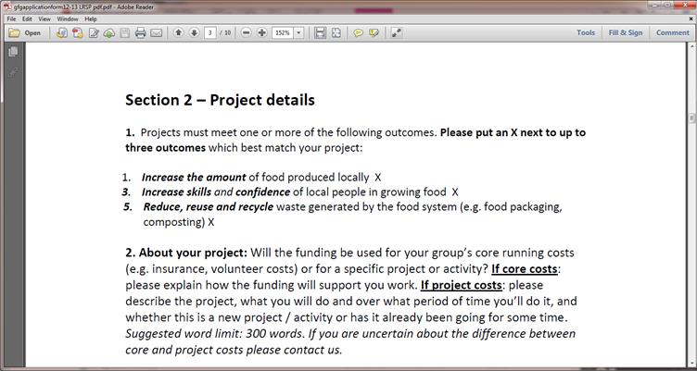
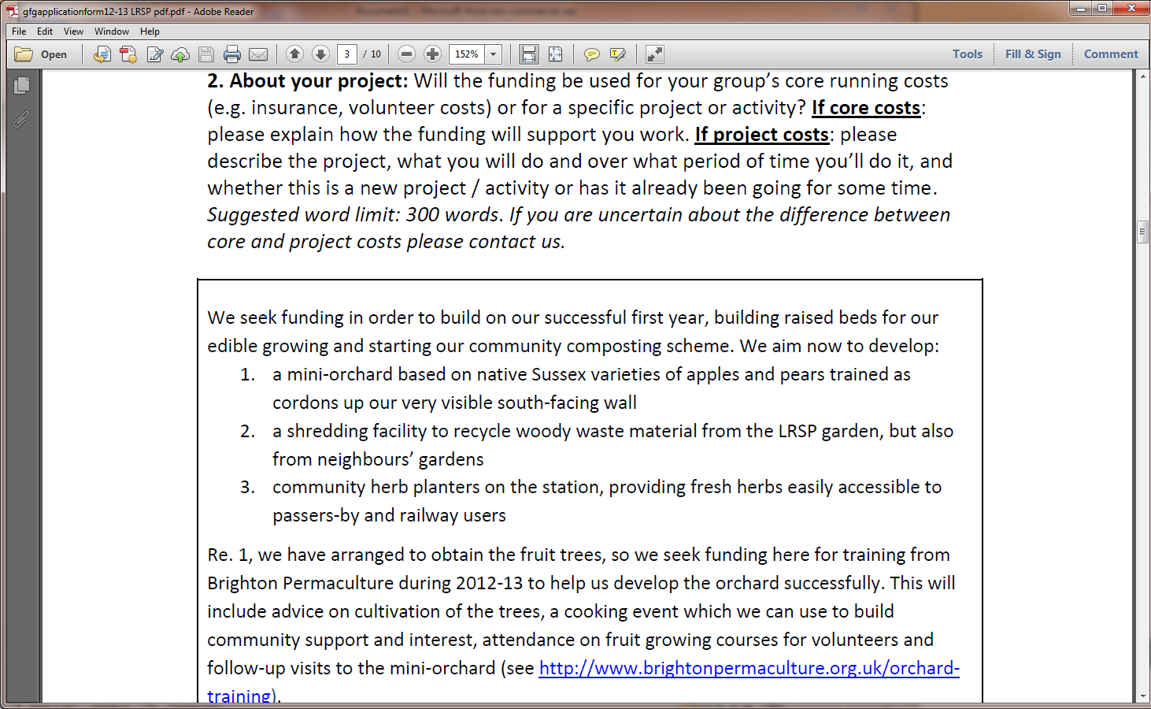
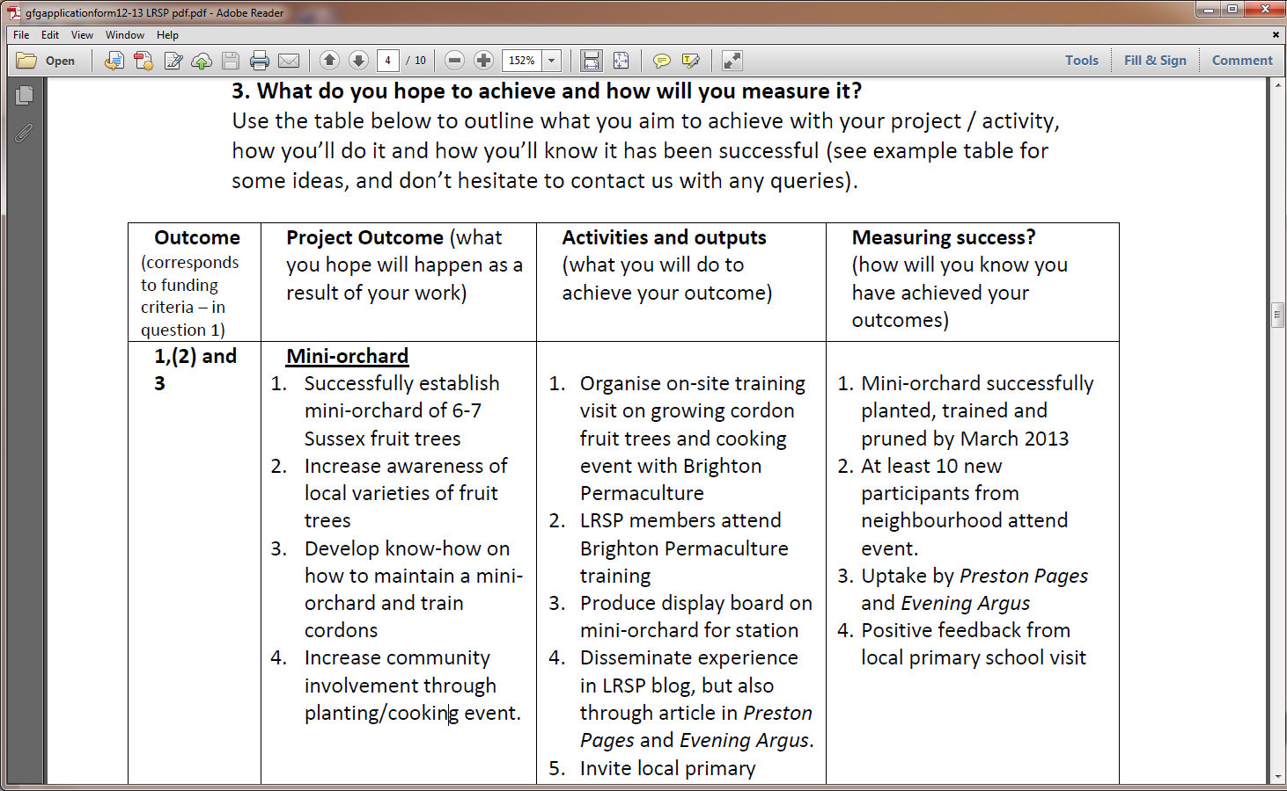

Slide 11
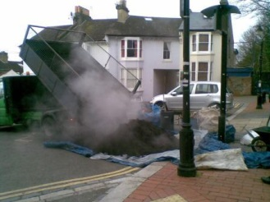
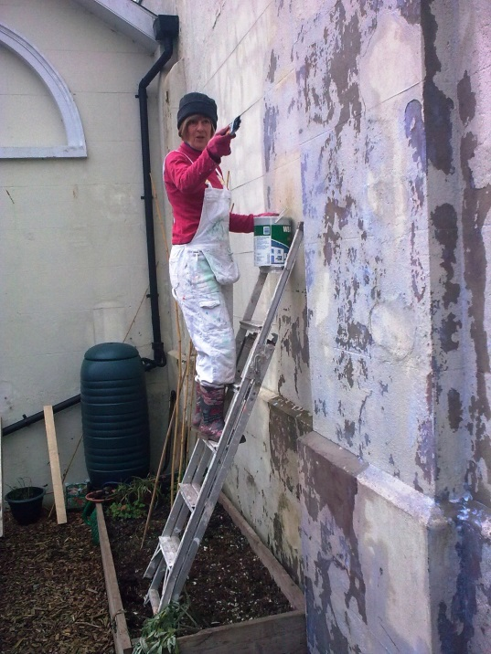
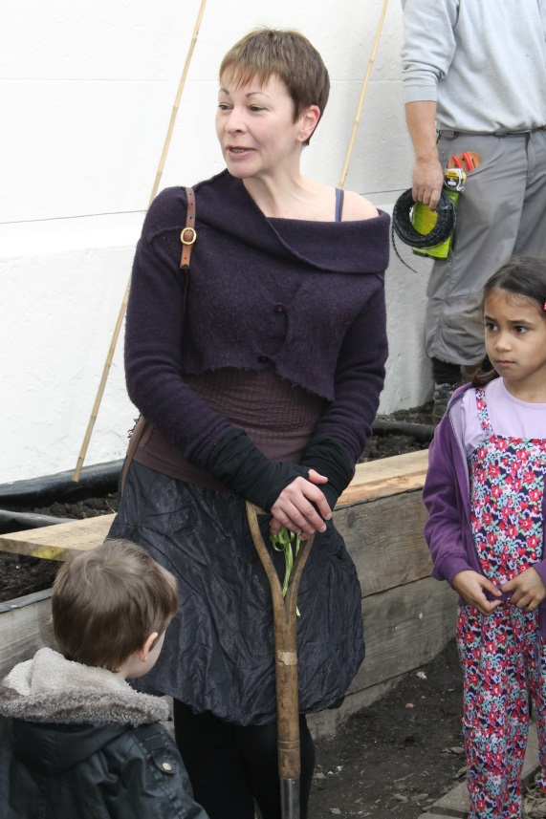
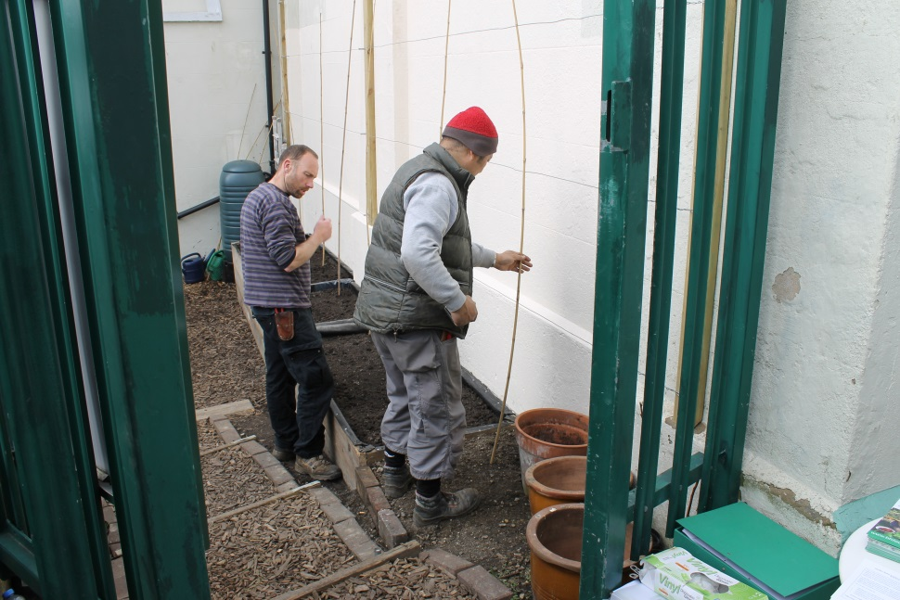
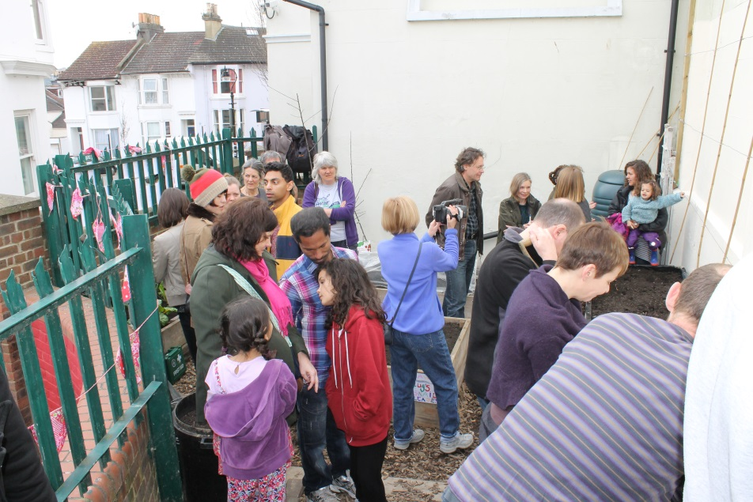
Link with bigger groups, apply for grants, approach local business,
involve your local community in events

Slide 12
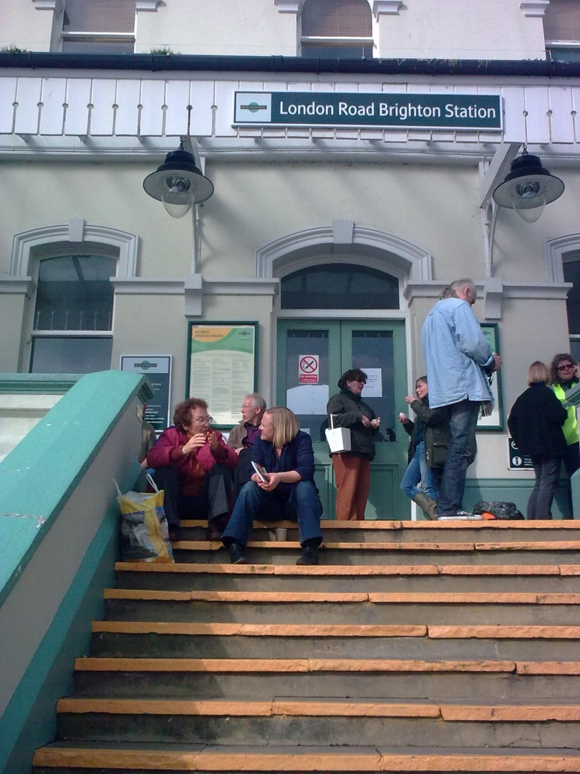
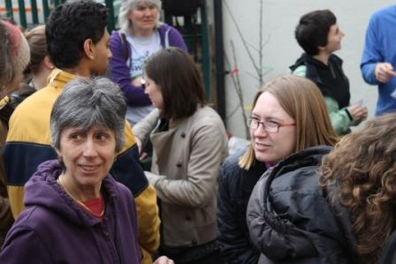
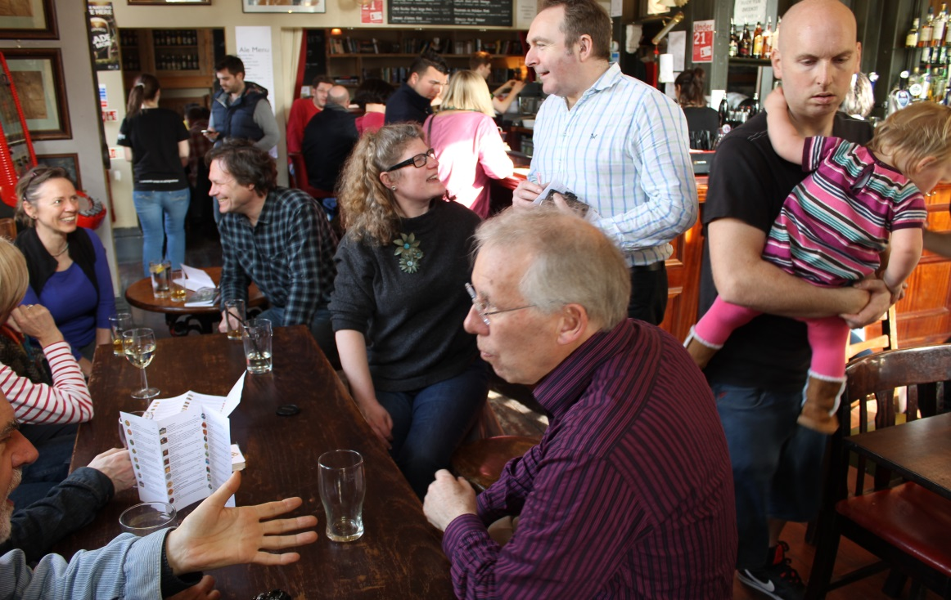
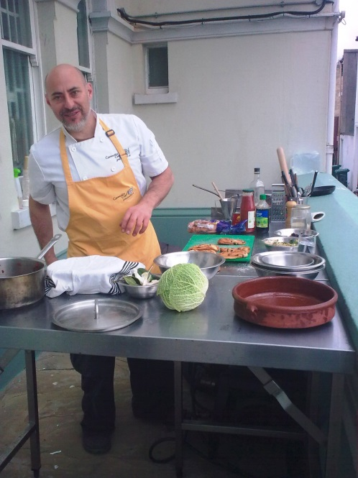

Slide 13
Core costs = for general funding
Project costs = for specific projects
Grants require you to be very specific … and accountable in detail.
Sponsorship from local businesses is less specific, but requires acknowledgement.
Donations usually come with no particular ‘strings’ attached – except trust.

Slide 14
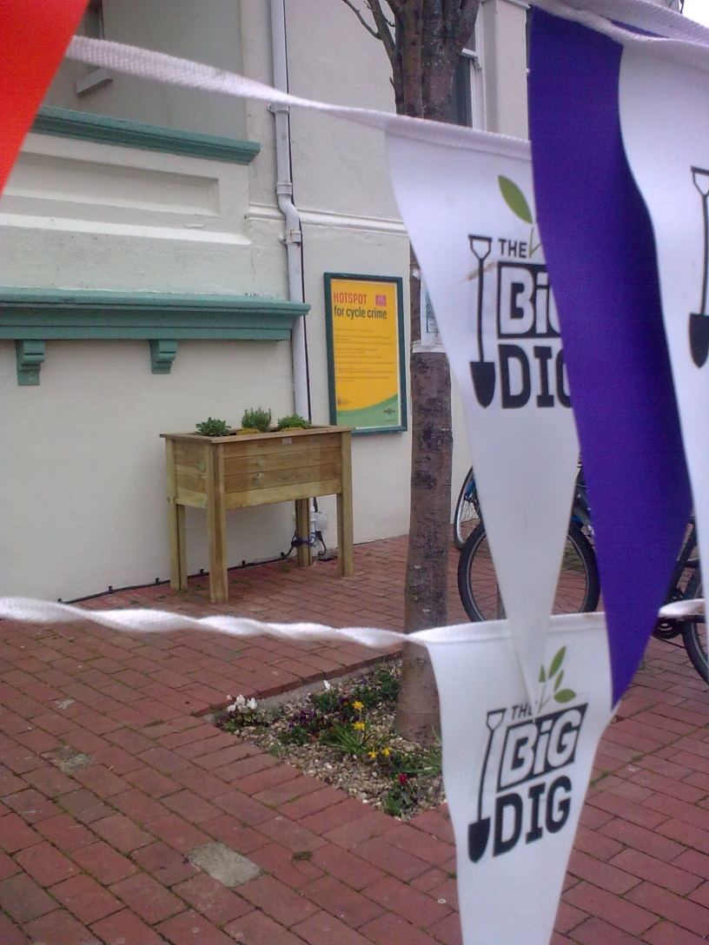
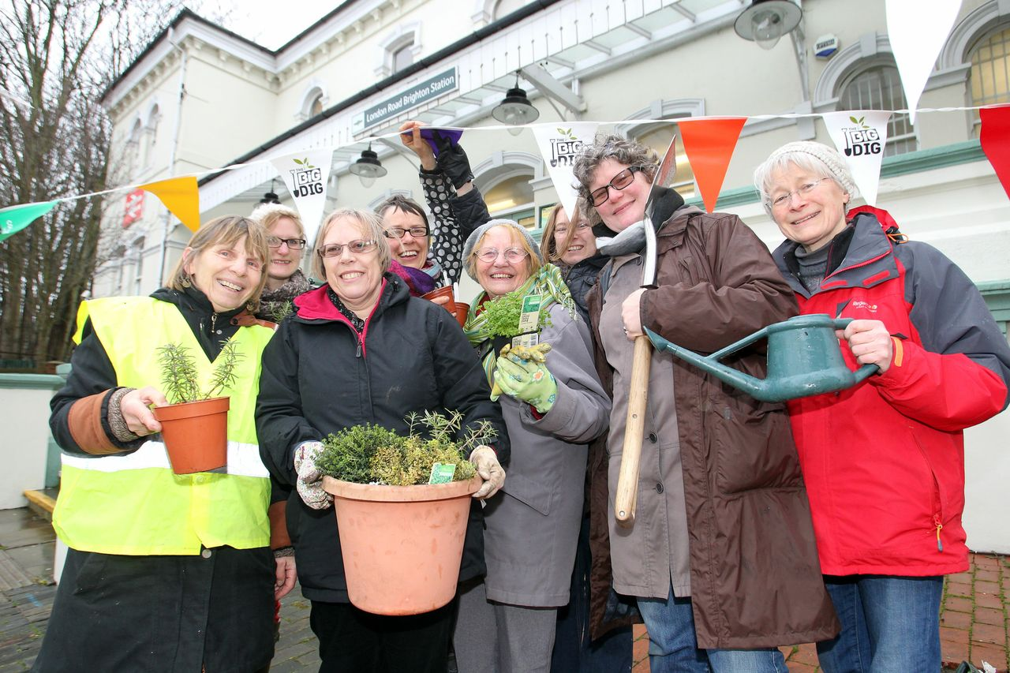

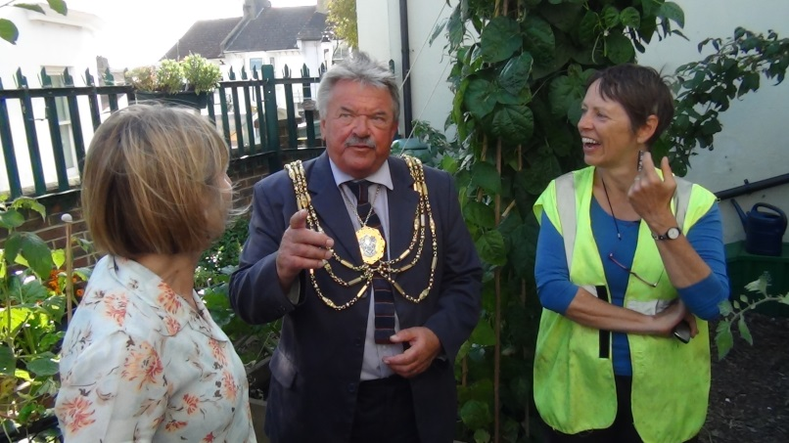
CASE STUDY 3 The Big Dig

Slide 15
The Big Dig – a national scheme 2012-13 to promote volunteering in community gardens
Coordinated by Brighton&Hove Food Partnership: as a Big Dig garden, we had to encourage more volunteers, report on our numbers and participate in Open Days.
We received around £50 per quarter to cover ‘admin’ and ‘volunteer’ costs
We often donated back our ‘admin’ costs to boost our core funds
Visitors often made small donations at Open Days

Slide 16
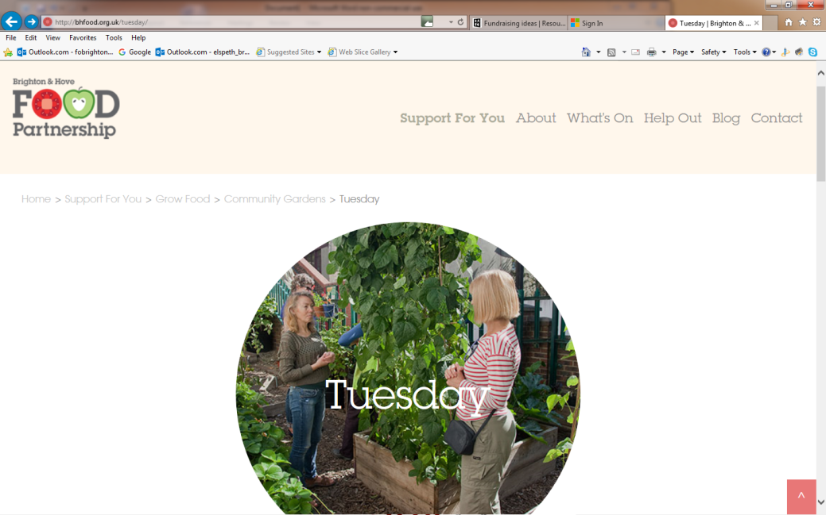
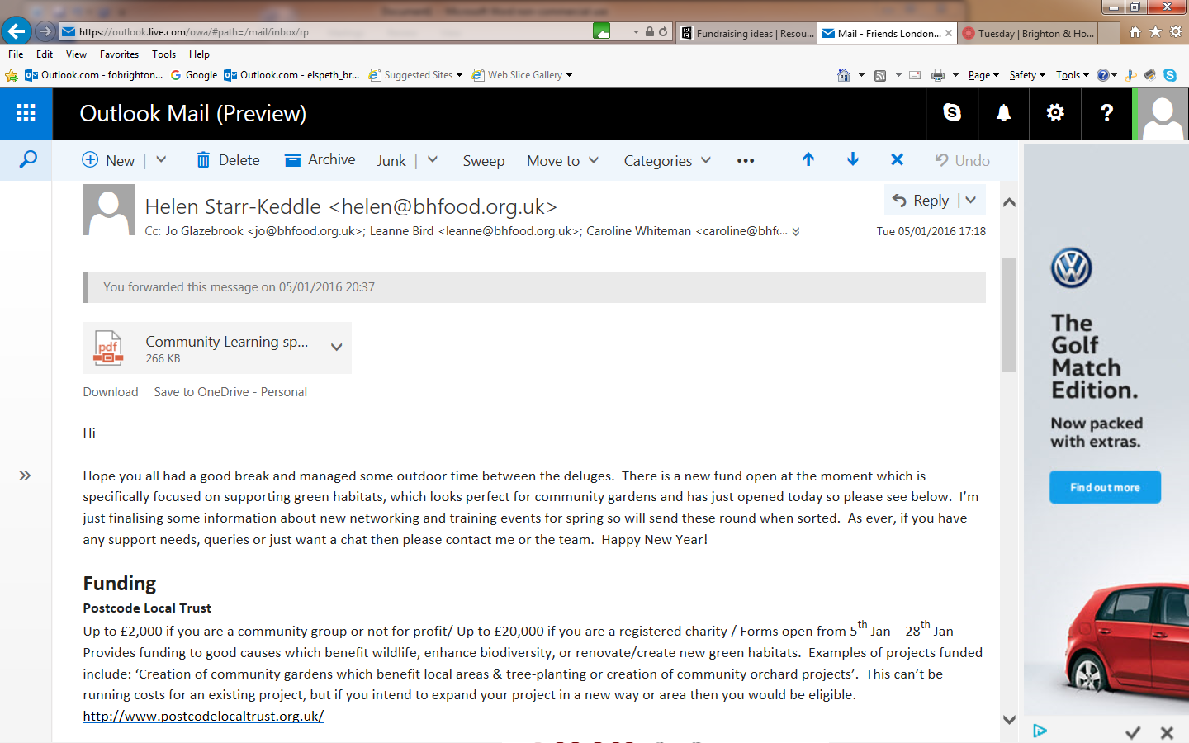
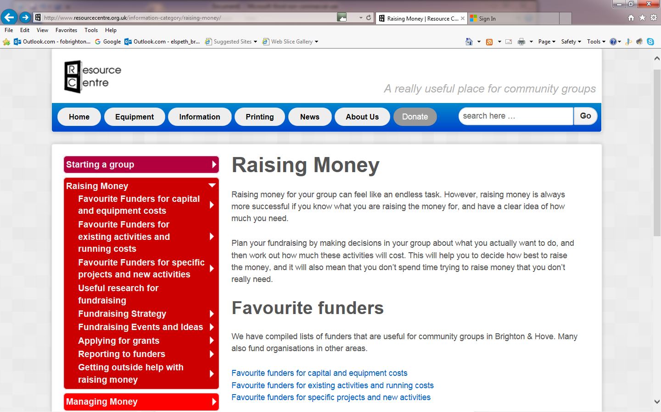
Resources and links

Slide 17
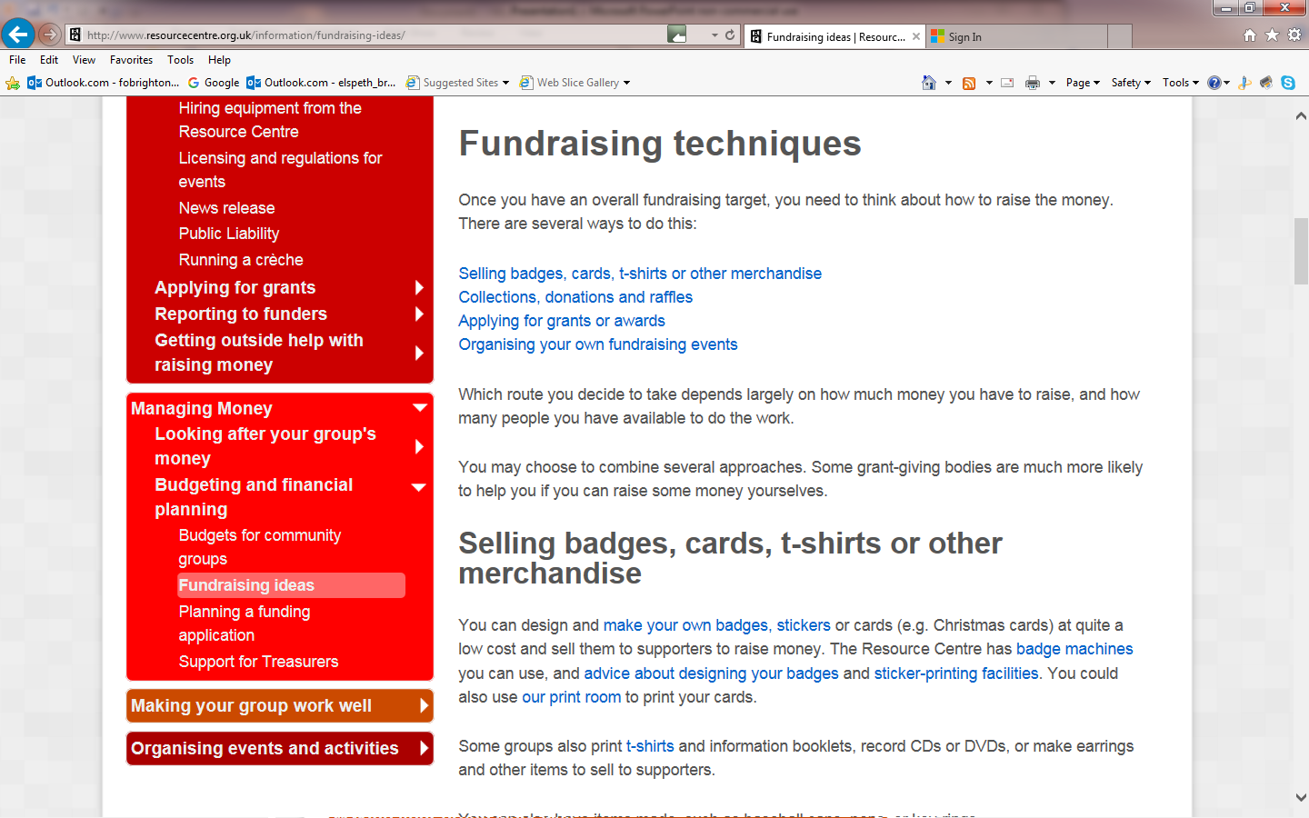

Slide 18
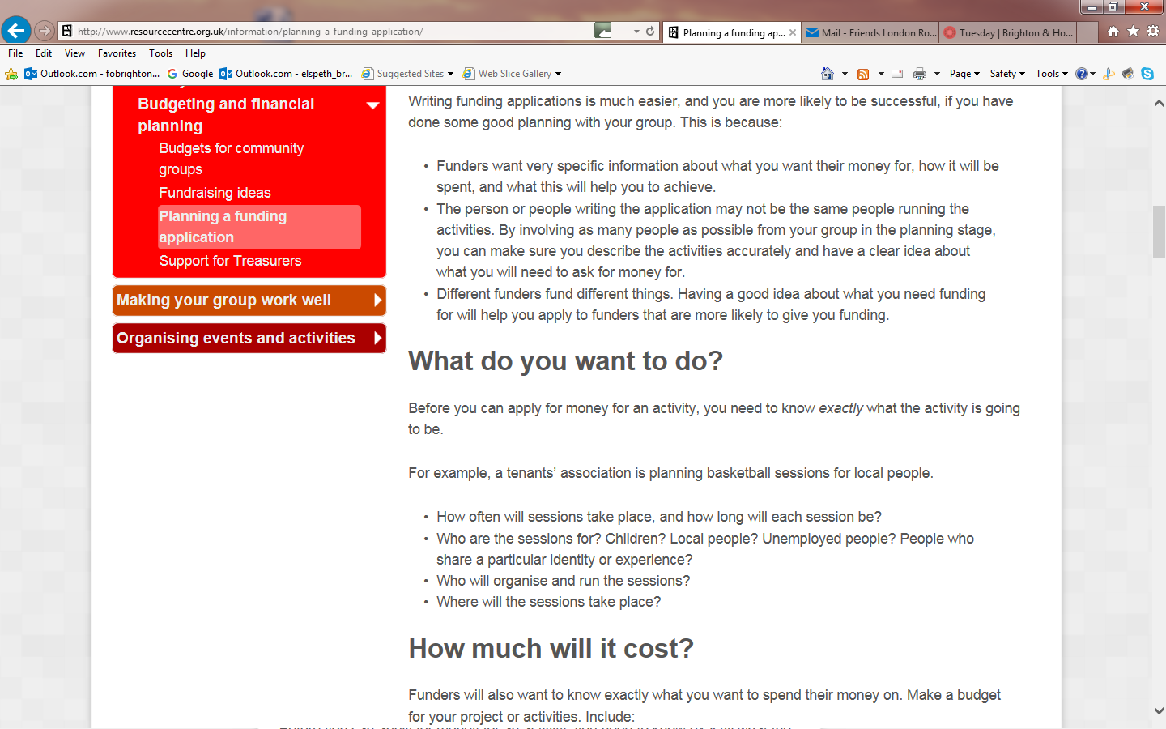

Slide 19
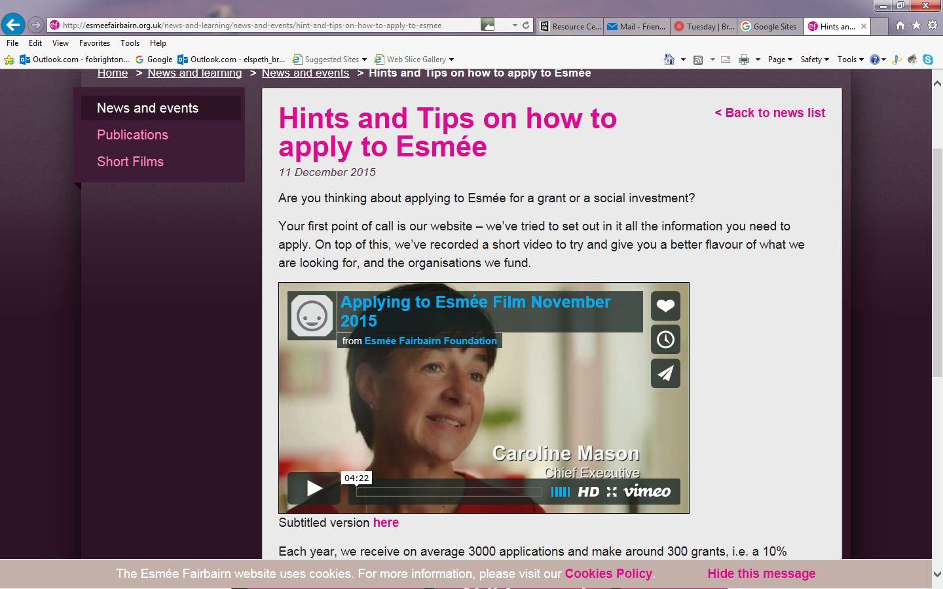
http://esmeefairbairn.org.uk/news-and-learning/news-and-events/hint-and-tips-on-how-to-apply-to-esmee

Slide 20
London Road Station Partnership
https://londonrdstationpartnership.wordpress.com/
Email: lrsp@hotmail.co.uk
Twitter: @lrspelspeth

